Slide 1
Airline Customer Service
Twitter customer service
Presented by : Kenny Barza
Khalil Hajal

Slide 2
Outline
What is the average tweet length of an employee at a customer service?
What is the frequency of tweets of employees at a customer service team?
When does the tram most frequently tweet?
Which methods to use in order to assist the customer?
What words and phrases are being used?
What is the employee tone? Is it positive, negative or neutral?

Slide 3
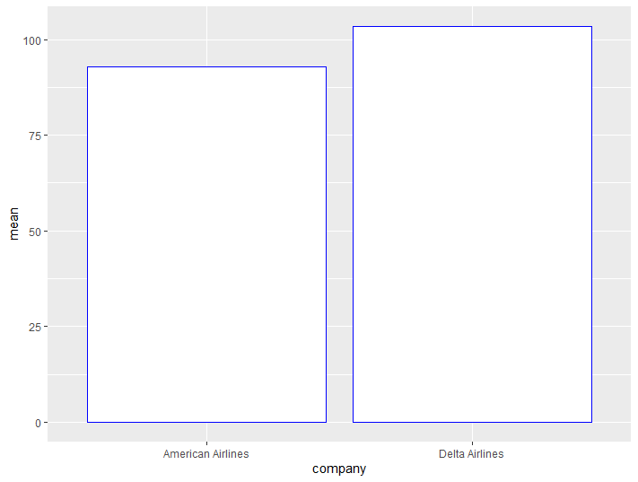
What is the Average tweet length?

Slide 4
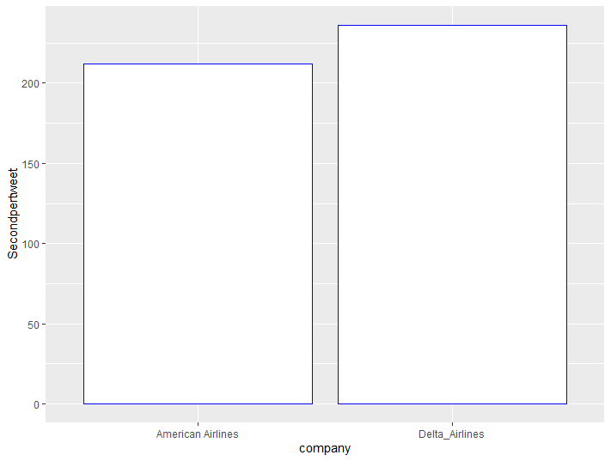
How many tweets to expect?

Slide 5
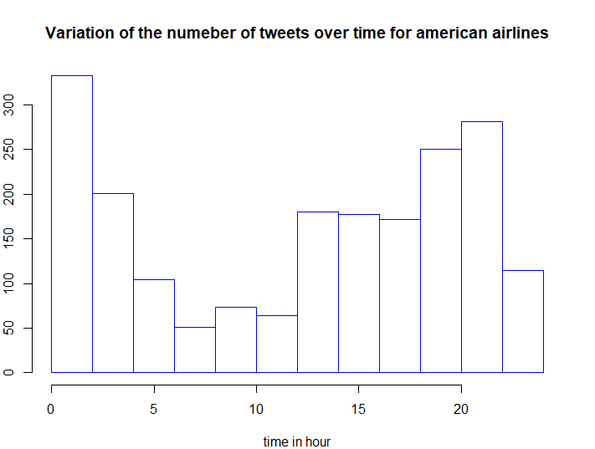
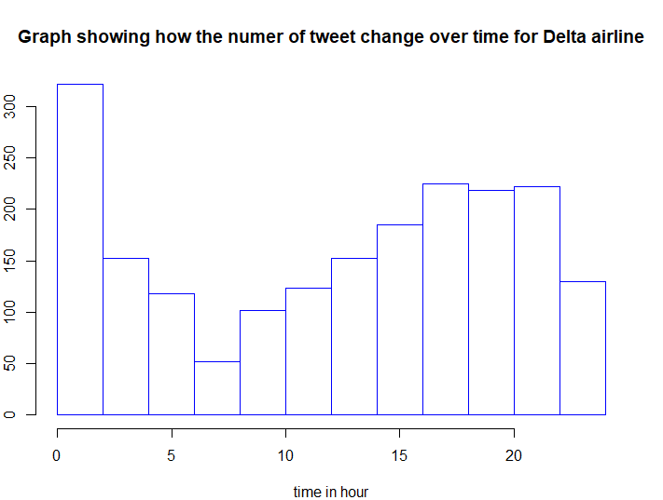
When do the Employee Most Often Tweet
American Airlines
Delta Airlines

Slide 6
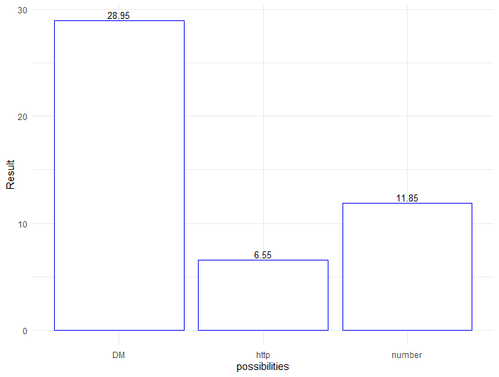
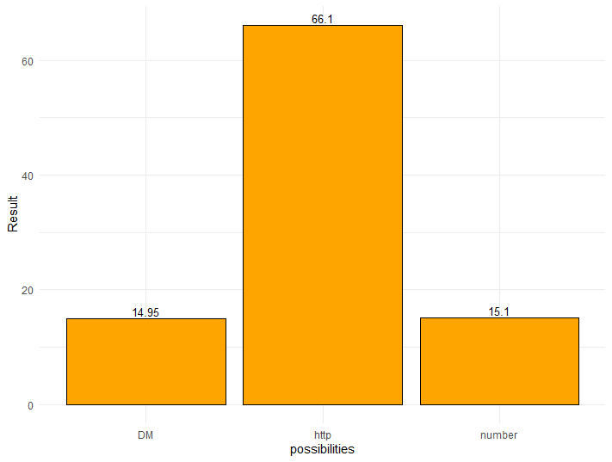
Which Methods do the Employees use in Order to Assist Customers?
American airlines
Delta Airlines

Slide 7
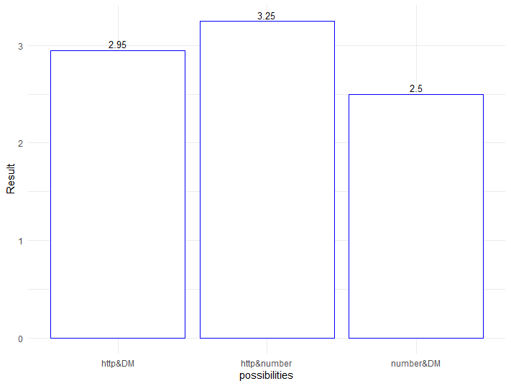
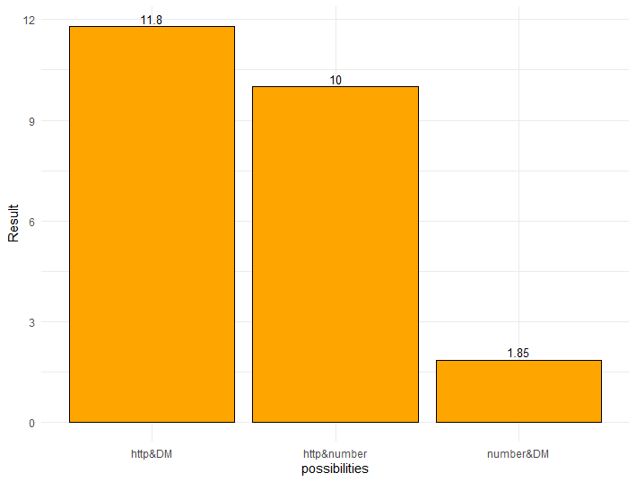
Which Methods do the Employees use in Order to Assist Customers?
American Airlines
Delta Airlines

Slide 8
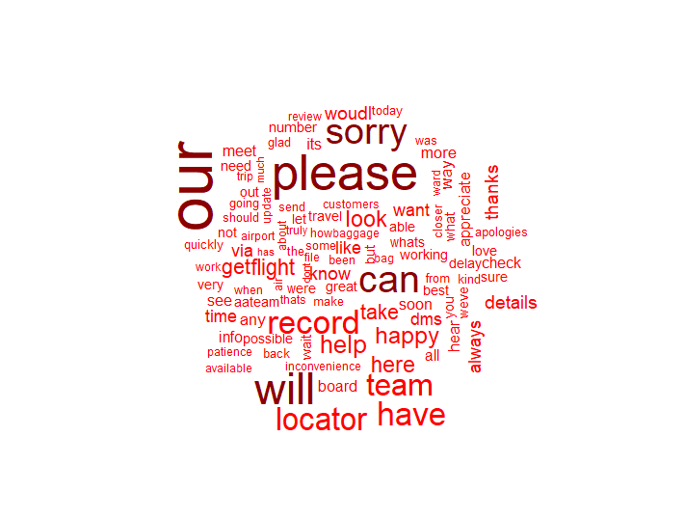
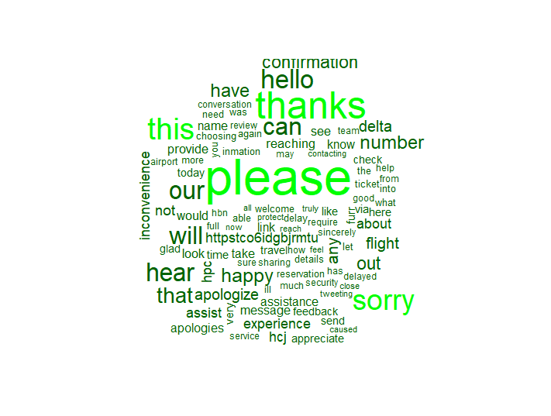
What Words or Phrases Have Been Used?
American Airlines
Delta Airlines

Slide 9
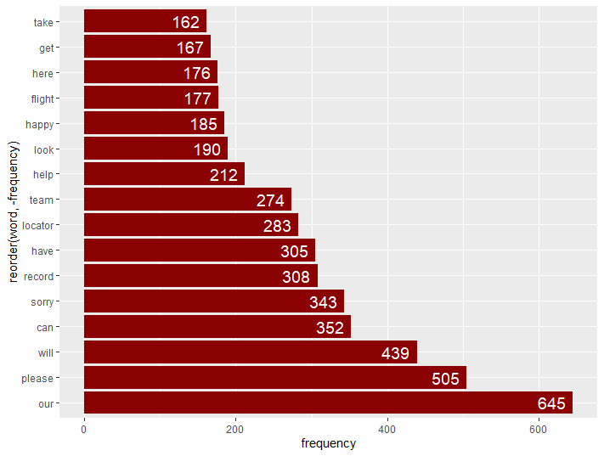
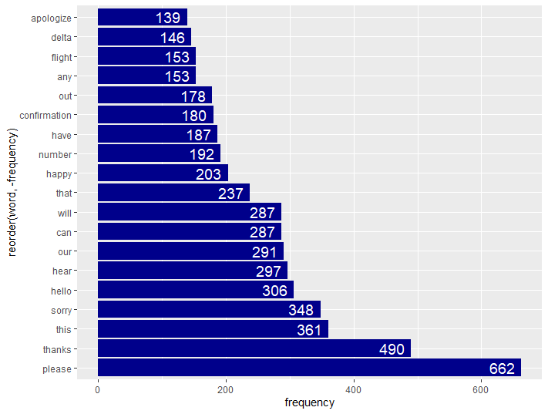
A More Specific Study
American Airlines
Delta Airlines

Slide 10
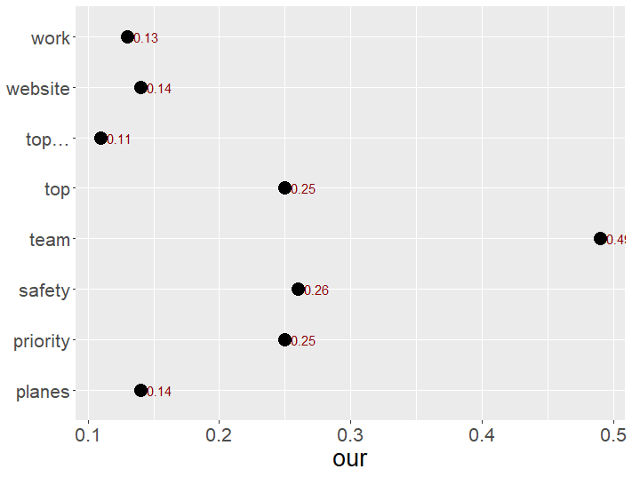
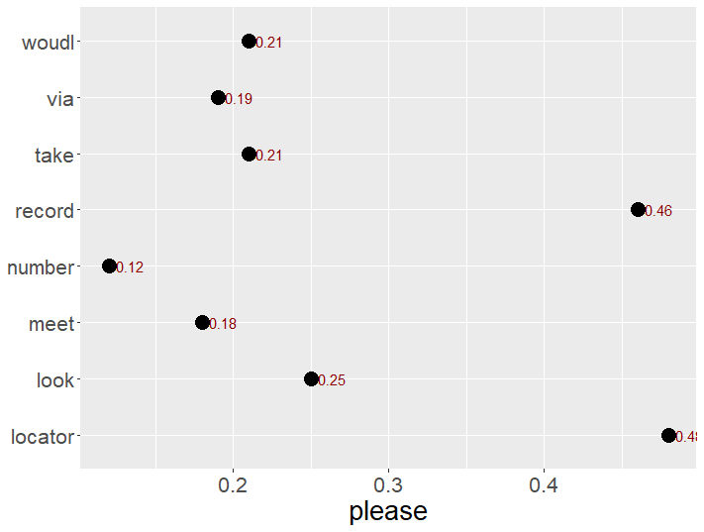
Word Association : American Airlines

Slide 11
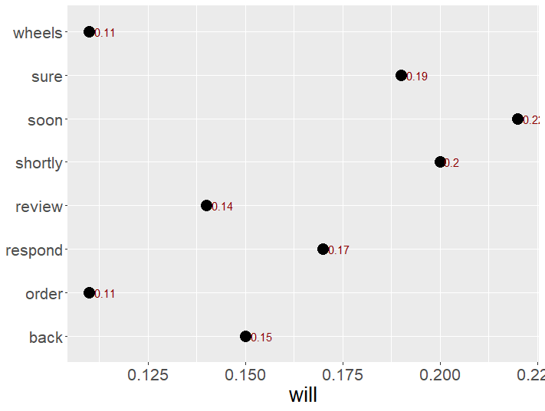
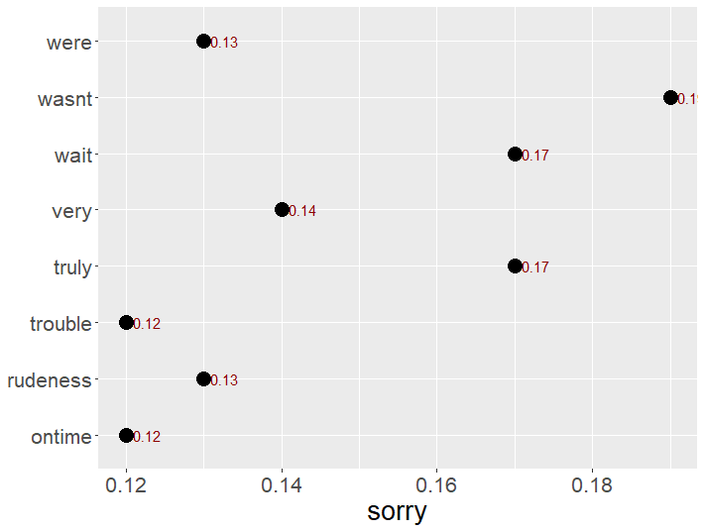
Word Association: American Airlines

Slide 12
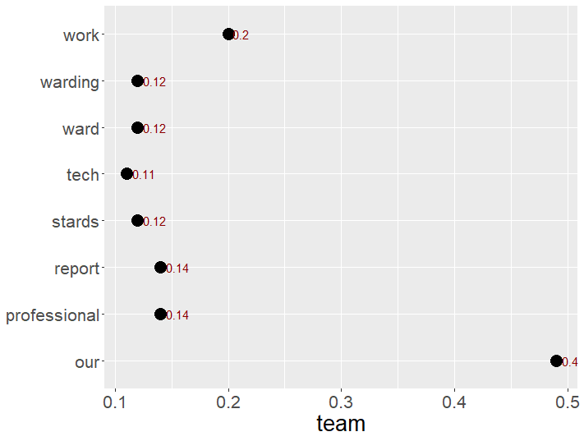
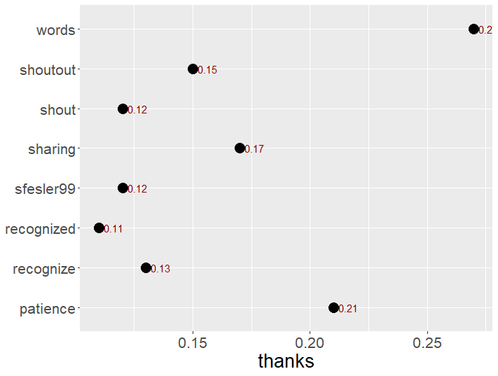
Word association: American Airlines

Slide 13
Example of Phrases that can Be Deduced
“Please send details”
“Our team will be looking…”
“Thanks for your patience”
“Flight delayed”
“Flight update”
“Sorry to hear, very sorry, truly sorry for any inconvenience
“gladly help you”

Slide 14
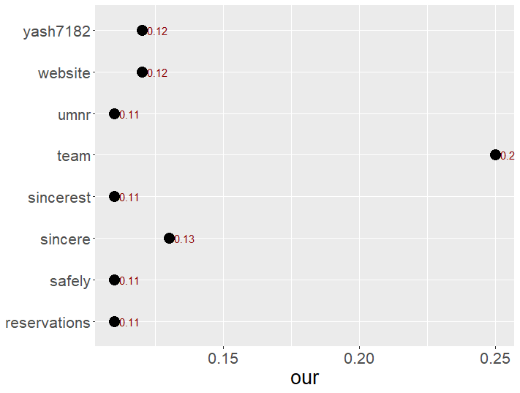
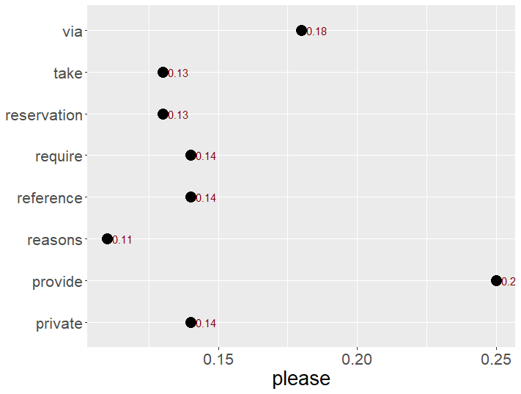
Word Association: Delta Airlines

Slide 15
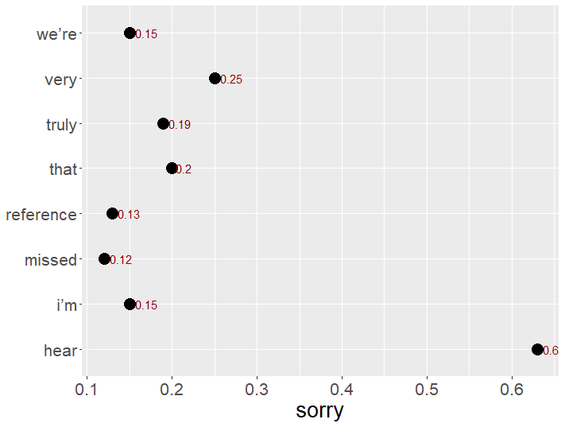
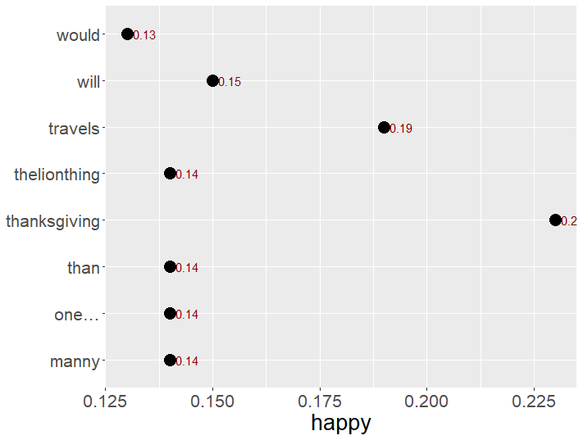
Word Association: Delta Airlines

Slide 16
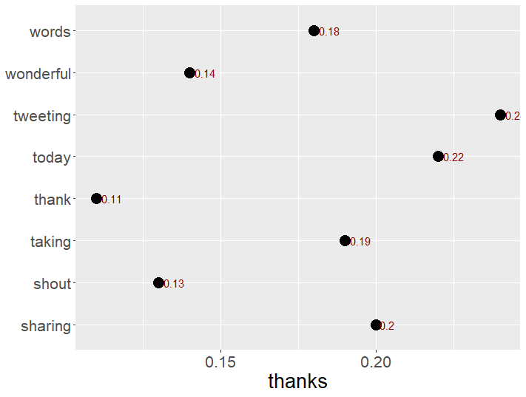
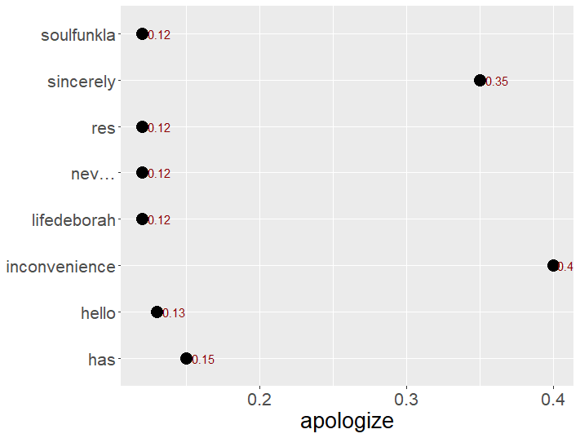
Word Association: Delta Airlines

Slide 17
Example of Phrases that can Be Deduced
“We apologize for the deal”
“Please give me the number of your flight”
“Confirmation Dates”
“Happy to assist you”
“Thanks for your feedback”

Slide 18
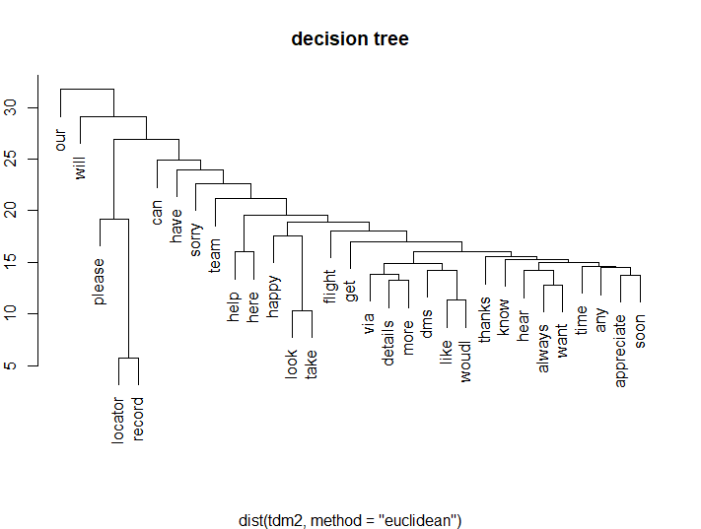
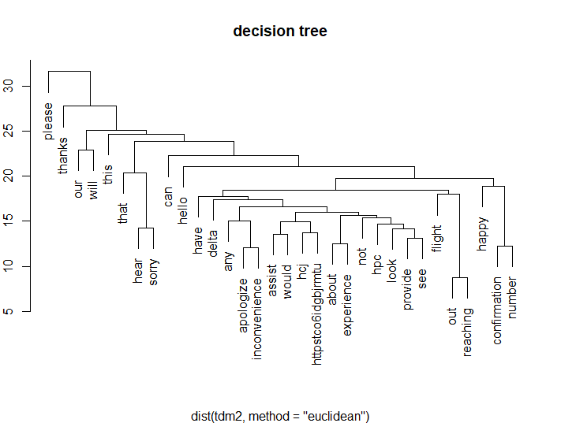
Tree Representation
American Airlines
Delta Airlines

Slide 19
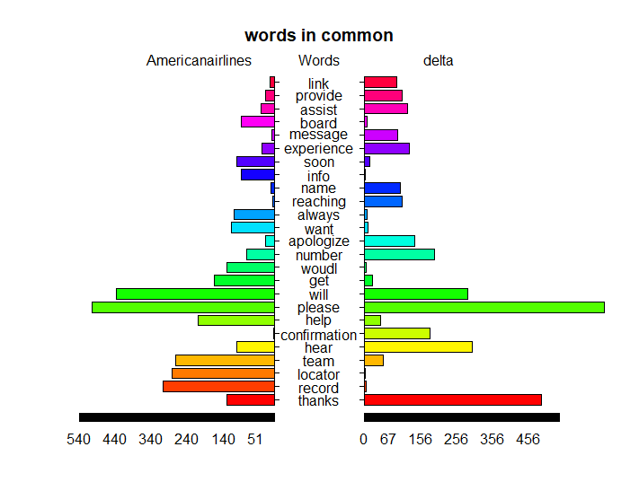
Two different approaches?

Slide 20
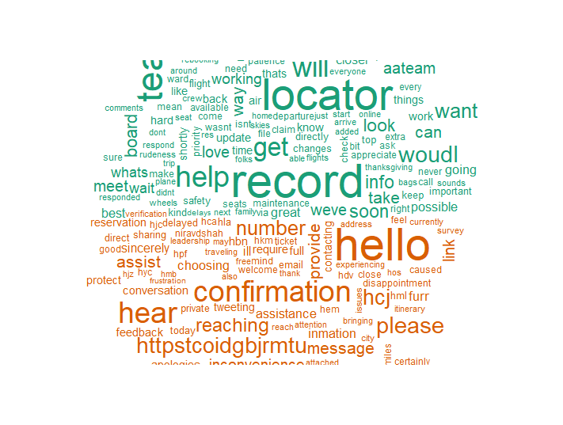

Slide 21
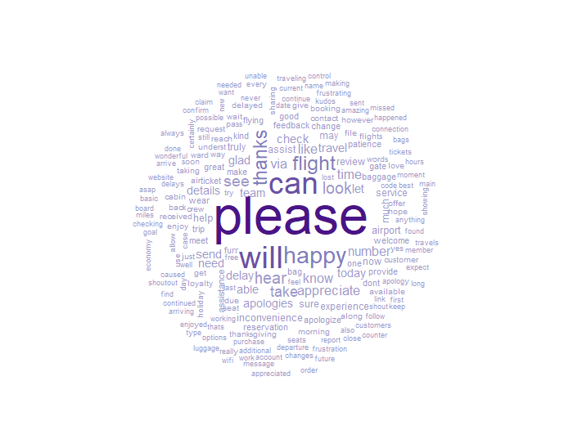

Slide 22
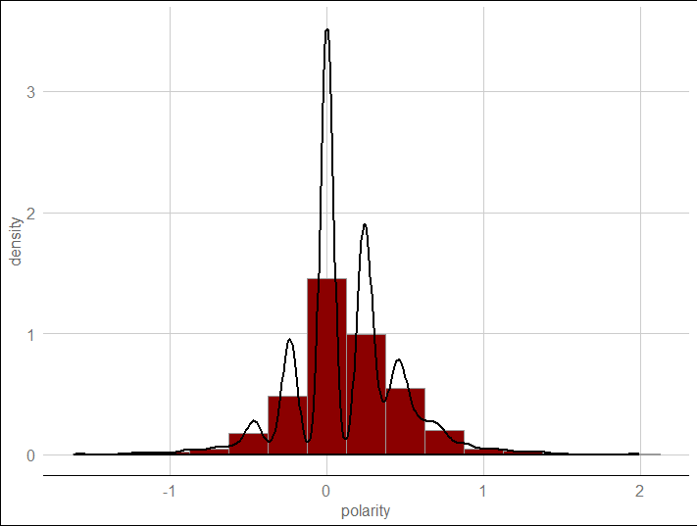
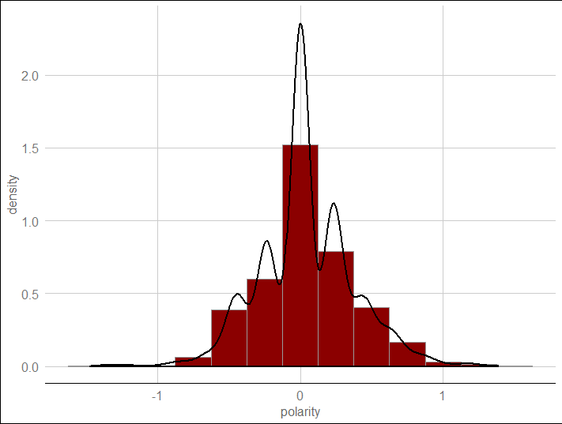
What is the Tone used by employees?
American Airlines
Delta Airlines

Slide 23
Conclusion

